Slide 1
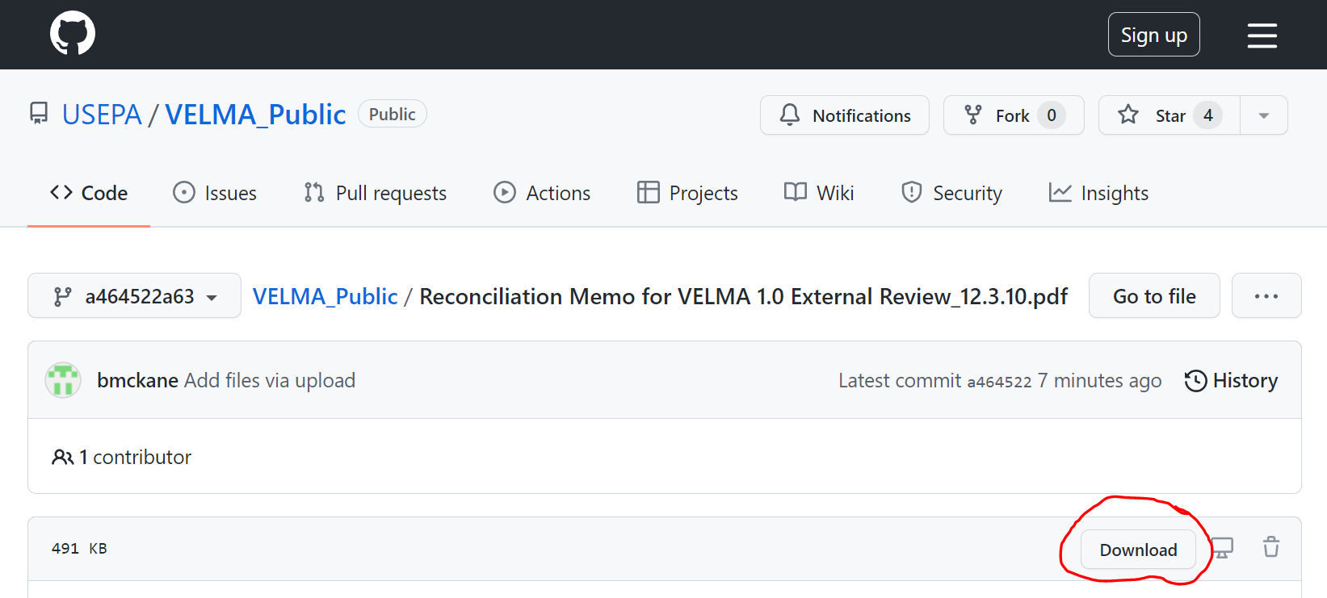
Timelines for VELMA Development, Peer Review, Products, Decision Support
2008 2010 2012 2014 2016 2018 2020 2022 2024 2026
VELMA 1.0
Development
VELMA 1.0
external review
VELMA 1.0 papers 1 & 2
VELMA 2.0 Development (code & documentation maintained on EPA VELMA GitHub site)
For details press Ctrl+Click on underscored links for details, then click “Download” on GitHub website that appears
VELMA 2.0
Website & User Manual
VELMA 2.0 Publications, Conference Presentations
Decision Support for Regions, States, Tribes, Communities
VELMA 2.1 Development & User Manual
VELMA 2.1 EPA review
VELMA 2.1 StRAP
Planning
Projected VELMA 2.1 Applications, Decision Support

